Slide 1
Supply, Demand,
and Government Policies
© 2015 Cengage Learning. All Rights Reserved. May not be copied, scanned, or duplicated, in whole or in part, except for use as permitted in a license distributed with a certain product or service or otherwise on a password-protected website for classroom use.

Slide 2
Controls on Prices
Price controls
  Usually enacted when policymakers believe that the market price of a good or service is unfair to buyers or sellers
  Can generate inequities
Taxes
  Used to raise revenue for public purposes and to influence market outcomes
© 2015 Cengage Learning. All Rights Reserved. May not be copied, scanned, or duplicated, in whole or in part, except for use as permitted in a license distributed with a certain product or service or otherwise on a password-protected website for classroom use.

Slide 3
Controls on Prices
Price ceiling
  A legal maximum on the price at which a good can be sold
Price floor
  A legal minimum on the price at which a good can be sold
© 2015 Cengage Learning. All Rights Reserved. May not be copied, scanned, or duplicated, in whole or in part, except for use as permitted in a license distributed with a certain product or service or otherwise on a password-protected website for classroom use.

Slide 4
Controls on Prices
How price ceilings affect market outcomes
  Not binding
    Set above the equilibrium price
    No effect on the price or quantity sold
  Binding constraint
    Set below the equilibrium price
    Shortage
    Sellers must ration the scarce goods
      Long lines
      Discrimination according to sellers bias
© 2015 Cengage Learning. All Rights Reserved. May not be copied, scanned, or duplicated, in whole or in part, except for use as permitted in a license distributed with a certain product or service or otherwise on a password-protected website for classroom use.

Slide 5
Figure 1
A Market with a Price Ceiling
(a) A Price Ceiling That Is Not Binding
(b) A Price Ceiling That Is Binding
Price of Ice-Cream
Cones
Price of Ice-Cream
Cones
Supply
Supply
$4
Price ceiling
Equilibrium
price
3
$3
Equilibrium
price
2
Price ceiling
Demand
Shortage
Demand
Equilibrium
quantity
Quantity
supplied
Quantity
demanded
0
100
0
75
125
Quantity of Ice-Cream Cones
Quantity of Ice-Cream Cones
In panel (a), the government imposes a price ceiling of $4. Because the price ceiling is above the equilibrium price of $3, the price ceiling has no effect, and the market can reach the equilibrium of supply and demand. In this equilibrium, quantity supplied and quantity demanded both equal 100 cones. In panel (b), the government imposes a price ceiling of $2. Because the price ceiling is below the equilibrium price of $3, the market price equals $2. At this price, 125 cones are demanded and only 75 are supplied, so there is a shortage of 50 cones.
© 2015 Cengage Learning. All Rights Reserved. May not be copied, scanned, or duplicated, in whole or in part, except for use as permitted in a license distributed with a certain product or service or otherwise on a password-protected website for classroom use.

Slide 6
Lines at the gas pump
1973, OPEC raised the price of crude oil
  Reduced the supply of gasoline
  Long lines at gas stations
What was responsible for the long gas lines?
  OPEC
    Shortage of gasoline
  U.S. government regulations
    Price ceiling on gasoline
© 2015 Cengage Learning. All Rights Reserved. May not be copied, scanned, or duplicated, in whole or in part, except for use as permitted in a license distributed with a certain product or service or otherwise on a password-protected website for classroom use.

Slide 7
Lines at the gas pump
Price ceiling on gasoline
  Before OPEC raised the price of crude oil
    Equilibrium price was below the price ceiling
      No effect on the market
  When the price of crude oil rose
    Decrease in the supply of gasoline
    Equilibrium price was above the price ceiling
      Binding price ceiling
      Severe shortage
Laws regulating the price of gasoline were repealed
© 2015 Cengage Learning. All Rights Reserved. May not be copied, scanned, or duplicated, in whole or in part, except for use as permitted in a license distributed with a certain product or service or otherwise on a password-protected website for classroom use.

Slide 8
Figure 2
The Market for Gasoline with a Price Ceiling
(a) The Price Ceiling On Gasoline Is Not Binding
(b) The Price Ceiling On Gasoline Is Binding
Price of Gasoline
Price of Gasoline
1. Initially, the price ceiling is not binding …
S₂
2…but when supply falls…
Supply, S₁
S₁
P₂
Price ceiling
Price ceiling
3…the price ceiling becomes binding…
P₁
P₁
4. …resulting in a shortage
Demand
Demand
0
Q₁
Quantity of Gasoline
0
Q_{S}
Q_{D}
Q₁
Quantity of Gasoline
Panel (a) shows the gasoline market when the price ceiling is not binding because the equilibrium price, P₁, is below the ceiling. Panel (b) shows the gasoline market after an increase in the price of crude oil (an input into making gasoline) shifts the supply curve to the left from S₁ to S₂. In an unregulated market, the price would have risen from P₁ to P₂. The price ceiling, however, prevents this from happening. At the binding price ceiling, consumers are willing to buy Q_{D}, but producers of gasoline are willing to sell only Q_{S}. The difference between quantity demanded and quantity supplied, Q_{D} – Q_{S}, measures the gasoline shortage.
© 2015 Cengage Learning. All Rights Reserved. May not be copied, scanned, or duplicated, in whole or in part, except for use as permitted in a license distributed with a certain product or service or otherwise on a password-protected website for classroom use.

Slide 9
Rent control in the short run and the long run
Price ceiling: rent control
  Local government places a ceiling on rents
  Goal: to help the poor
    Making housing more affordable
  Critique
    Highly inefficient way to help the poor raise their standard of living
© 2015 Cengage Learning. All Rights Reserved. May not be copied, scanned, or duplicated, in whole or in part, except for use as permitted in a license distributed with a certain product or service or otherwise on a password-protected website for classroom use.

Slide 10
Rent control in the short run and the long run
Adverse effects in the short run
  Supply and demand for housing are relatively inelastic
  Small shortage
  Reduced rents
© 2015 Cengage Learning. All Rights Reserved. May not be copied, scanned, or duplicated, in whole or in part, except for use as permitted in a license distributed with a certain product or service or otherwise on a password-protected website for classroom use.

Slide 11
Rent control in the short run and the long run
Adverse effects in the long run
  Supply and demand are more elastic
    Landlords
      Are not building new apartments
      Are failing to maintain existing ones
    People
      Find their own apartments
      Induce more people to move into a city
    Large shortage of housing
© 2015 Cengage Learning. All Rights Reserved. May not be copied, scanned, or duplicated, in whole or in part, except for use as permitted in a license distributed with a certain product or service or otherwise on a password-protected website for classroom use.

Slide 12
Rent control in the short run and the long run
Adverse effects in the long run
  Rationing mechanisms
    Long waiting lists
    Preference to tenants without children
    Discriminate on the basis of race
    Bribes to building superintendents
People respond to incentives
  Free markets
    Landlords – clean and safe buildings
    Higher prices
© 2015 Cengage Learning. All Rights Reserved. May not be copied, scanned, or duplicated, in whole or in part, except for use as permitted in a license distributed with a certain product or service or otherwise on a password-protected website for classroom use.

Slide 13
Rent control in the short run and the long run
People respond to incentives
  Rent control
    Shortages and waiting lists
    Landlords lose their incentive to respond to tenants’ concerns
    Tenants get lower rents and lower-quality housing
Policymakers – additional regulations
  Difficult and costly to enforce
© 2015 Cengage Learning. All Rights Reserved. May not be copied, scanned, or duplicated, in whole or in part, except for use as permitted in a license distributed with a certain product or service or otherwise on a password-protected website for classroom use.

Slide 14
Figure 3
Rent Control in the Short Run and in the Long Run
(a) Rent Control in the Short Run
(supply and demand are inelastic)
(b) Rent Control in the Long Run
(supply and demand are elastic)
Rental Price of Apartment
Rental Price of Apartment
Supply
Supply
Controlled rent
Controlled rent
Shortage
Demand
Demand
Shortage
0
Quantity of Apartments
0
Quantity of Apartments
Panel (a) shows the short-run effects of rent control: Because the supply and demand for apartments are relatively inelastic, the price ceiling imposed by a rent-control law causes only a small shortage of housing. Panel (b) shows the long-run effects of rent control: Because the supply and demand for apartments are more elastic, rent control causes a large shortage.
© 2015 Cengage Learning. All Rights Reserved. May not be copied, scanned, or duplicated, in whole or in part, except for use as permitted in a license distributed with a certain product or service or otherwise on a password-protected website for classroom use.

Slide 15
Controls on Prices
How price floors affect market outcomes
  Not binding
    Set below the equilibrium price
    No effect on the market
  Binding constraint
    Set above the equilibrium price
    Surplus
    Some sellers are unable to sell what they want
      The rationing mechanisms: not desirable
© 2015 Cengage Learning. All Rights Reserved. May not be copied, scanned, or duplicated, in whole or in part, except for use as permitted in a license distributed with a certain product or service or otherwise on a password-protected website for classroom use.

Slide 16
Figure 4
A Market with a Price Floor
(A) A Price Floor That Is Not Binding
(B) A Price Floor That Is Binding
Price of Ice-Cream
Cone
Price of Ice-Cream
Cone
Supply
Surplus
Supply
$4
Price floor
$3
3
Equilibrium
price
Equilibrium
price
2
Price floor
Demand
Demand
Equilibrium
quantity
Quantity
demanded
Quantity
supplied
0
100
0
80
120
Quantity of Ice-Cream Cones
Quantity of Ice-Cream Cones
In panel (a), the government imposes a price floor of $2. Because this is below the equilibrium price of $3, the price floor has no effect. The market price adjusts to balance supply and demand. At the equilibrium, quantity supplied and quantity demanded both equal 100 cones. In panel (b), the government imposes a price floor of $4, which is above the equilibrium price of $3. Therefore, the market price equals $4. Because 120 cones are supplied at this price and only 80 are demanded, there is a surplus of 40 cones.
© 2015 Cengage Learning. All Rights Reserved. May not be copied, scanned, or duplicated, in whole or in part, except for use as permitted in a license distributed with a certain product or service or otherwise on a password-protected website for classroom use.

Slide 17
The minimum wage
Price floor: minimum wage
  Lowest price for labor that any employer may pay
Fair Labor Standards Act of 1938
  Ensure workers a minimally adequate standard of living
2012, federal minimum wage, $7.25/hour
  Some states mandate minimum wages above the federal level
© 2015 Cengage Learning. All Rights Reserved. May not be copied, scanned, or duplicated, in whole or in part, except for use as permitted in a license distributed with a certain product or service or otherwise on a password-protected website for classroom use.

Slide 18
The minimum wage
France
  Average income is 27% lower than in the U.S.
  Minimum wage 9.40 euros per hour ($12)
Market for labor
  Workers supply labor
  Firms demand labor
© 2015 Cengage Learning. All Rights Reserved. May not be copied, scanned, or duplicated, in whole or in part, except for use as permitted in a license distributed with a certain product or service or otherwise on a password-protected website for classroom use.

Slide 19
The minimum wage
If minimum wage is above equilibrium
  Unemployment
  Higher income for workers who have jobs
  Lower income for workers who cannot find jobs
Impact of the minimum wage on highly skilled and experienced workers
  No effect: their equilibrium wages are well above the minimum
  Minimum wage - not binding
© 2015 Cengage Learning. All Rights Reserved. May not be copied, scanned, or duplicated, in whole or in part, except for use as permitted in a license distributed with a certain product or service or otherwise on a password-protected website for classroom use.

Slide 20
The minimum wage
Impact of the minimum wage on teenage labor
  Least skilled and least experienced
  Low equilibrium wages
  Willing to accept a lower wage in exchange for on-the-job training
  Minimum wage – binding
© 2015 Cengage Learning. All Rights Reserved. May not be copied, scanned, or duplicated, in whole or in part, except for use as permitted in a license distributed with a certain product or service or otherwise on a password-protected website for classroom use.

Slide 21
The minimum wage
Teenage labor market
  A 10% increase in the minimum wage depresses teenage employment between 1 and 3%
  Some teenagers who are still attending high school choose to drop out and take jobs
    Displace other teenagers who had already dropped out of school and who now become unemployed
© 2015 Cengage Learning. All Rights Reserved. May not be copied, scanned, or duplicated, in whole or in part, except for use as permitted in a license distributed with a certain product or service or otherwise on a password-protected website for classroom use.

Slide 22
Figure 5
How the Minimum Wage Affects the Labor Market
(b) A Labor Market with a
Binding Minimum Wage
(a) A Free Labor Market
Wage
Wage
Labor
supply
Labor surplus
(unemployment)
Labor
supply
Minimum
wage
Equilibrium
wage
Labor
demand
Labor
demand
0
Equilibrium
employment
Quantity
of Labor
0
Quantity
demanded
Quantity
supplied
Quantity
of Labor
Panel (a) shows a labor market in which the wage adjusts to balance labor supply and labor demand. Panel (b) shows the impact of a binding minimum wage. Because the minimum wage is a price floor, it causes a surplus: The quantity of labor supplied exceeds the quantity demanded. The result is unemployment.
© 2015 Cengage Learning. All Rights Reserved. May not be copied, scanned, or duplicated, in whole or in part, except for use as permitted in a license distributed with a certain product or service or otherwise on a password-protected website for classroom use.

Slide 23
Evaluating Price Controls
Markets are usually a good way to organize economic activity
  Economists usually oppose price ceilings and price floors
  Prices are not the outcome of some haphazard process
  Prices have the crucial job of balancing supply and demand
    Coordinating economic activity
© 2015 Cengage Learning. All Rights Reserved. May not be copied, scanned, or duplicated, in whole or in part, except for use as permitted in a license distributed with a certain product or service or otherwise on a password-protected website for classroom use.

Slide 24
Evaluating Price Controls
Governments can sometimes improve market outcomes
  Want to use price controls
    Because of unfair market outcome
    Aimed at helping the poor
  Often hurt those they are trying to help
  Other ways of helping those in need
    Rent subsidies
    Wage subsidies
© 2015 Cengage Learning. All Rights Reserved. May not be copied, scanned, or duplicated, in whole or in part, except for use as permitted in a license distributed with a certain product or service or otherwise on a password-protected website for classroom use.

Slide 25
Taxes
Government use taxes
  To raise revenue for public projects
    Roads, schools, and national defense
Tax incidence
  Manner in which the burden of a tax is shared among participants in a market
© 2015 Cengage Learning. All Rights Reserved. May not be copied, scanned, or duplicated, in whole or in part, except for use as permitted in a license distributed with a certain product or service or otherwise on a password-protected website for classroom use.

Slide 26
Taxes
How taxes on sellers affect market outcomes
  Immediate impact on sellers: shift in supply
  Supply curve shifts left
  Higher equilibrium price
  Lower equilibrium quantity
  The tax reduces the size of the market
© 2015 Cengage Learning. All Rights Reserved. May not be copied, scanned, or duplicated, in whole or in part, except for use as permitted in a license distributed with a certain product or service or otherwise on a password-protected website for classroom use.

Slide 27
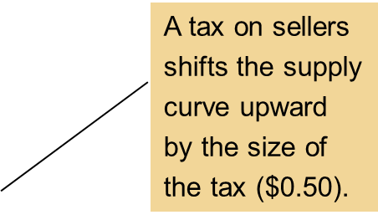
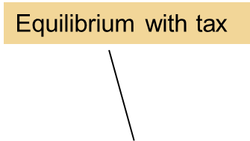
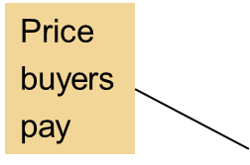
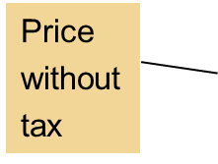
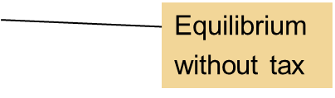
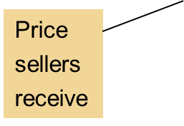
Figure 6
A Tax on Sellers
Price of
Ice-Cream
Cone
S₂
S₁
$3.30
3.00
Tax ($0.50)
2.80
Demand, D₁
0
90
100
Quantity of
Ice-Cream Cones
When a tax of $0.50 is levied on sellers, the supply curve shifts up by $0.50 from S₁ to S₂. The equilibrium quantity falls from 100 to 90 cones. The price that buyers pay rises from $3.00 to $3.30. The price that sellers receive (after paying the tax) falls from $3.00 to $2.80. Even though the tax is levied on sellers, buyers and sellers share the burden of the tax.
© 2015 Cengage Learning. All Rights Reserved. May not be copied, scanned, or duplicated, in whole or in part, except for use as permitted in a license distributed with a certain product or service or otherwise on a password-protected website for classroom use.

Slide 28
Taxes
How taxes on sellers affect market outcomes
  Taxes discourage market activity
  Buyers and sellers share the burden of tax
  Buyers pay more, are worse off
  Sellers receive less, are worse off
    Get the higher price but pay the tax
    Overall: effective price fall
© 2015 Cengage Learning. All Rights Reserved. May not be copied, scanned, or duplicated, in whole or in part, except for use as permitted in a license distributed with a certain product or service or otherwise on a password-protected website for classroom use.

Slide 29
Taxes
How taxes on buyers affect market outcomes
  Initial impact on the demand
  Demand curve shifts left
  Lower equilibrium price
  Lower equilibrium quantity
  The tax reduces the size of the market
© 2015 Cengage Learning. All Rights Reserved. May not be copied, scanned, or duplicated, in whole or in part, except for use as permitted in a license distributed with a certain product or service or otherwise on a password-protected website for classroom use.

Slide 30
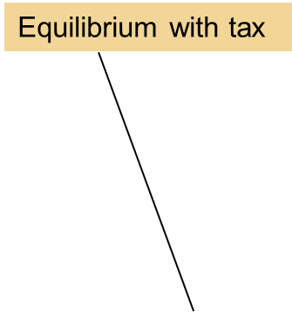
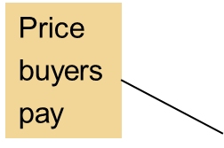
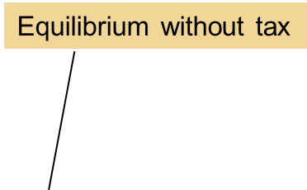
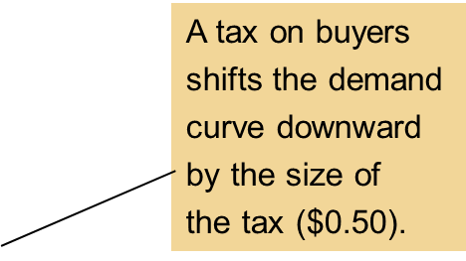

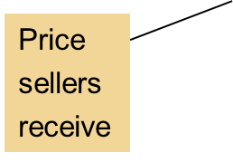
Figure 7
A Tax on Buyers
Price of
Ice-Cream
Cone
Supply, S₁
$3.30
3.00
Tax ($0.50)
2.80
D₁
D₂
0
90
100
Quantity of
Ice-Cream Cones
When a tax of $0.50 is levied on buyers, the demand curve shifts down by $0.50 from D₁ to D₂. The equilibrium quantity falls from 100 to 90 cones. The price that sellers receive falls from $3.00 to $2.80. The price that buyers pay (including the tax) rises from $3.00 to $3.30. Even though the tax is levied on buyers, buyers and sellers share the burden of the tax.
© 2015 Cengage Learning. All Rights Reserved. May not be copied, scanned, or duplicated, in whole or in part, except for use as permitted in a license distributed with a certain product or service or otherwise on a password-protected website for classroom use.

Slide 31
Taxes
How taxes on buyers affect market outcomes
  Buyers and sellers share the burden of tax
  Sellers get a lower price, are worse off
  Buyers pay a lower market price, are worse off
    Effective price (with tax) rises
© 2015 Cengage Learning. All Rights Reserved. May not be copied, scanned, or duplicated, in whole or in part, except for use as permitted in a license distributed with a certain product or service or otherwise on a password-protected website for classroom use.

Slide 32
Taxes
Taxes levied on sellers and taxes levied on buyers are equivalent
  Wedge between the price that buyers pay and the price that sellers receive
    The same, regardless of whether the tax is levied on buyers or sellers
  Shifts the relative position of the supply and demand curves
    Buyers and sellers share the tax burden
© 2015 Cengage Learning. All Rights Reserved. May not be copied, scanned, or duplicated, in whole or in part, except for use as permitted in a license distributed with a certain product or service or otherwise on a password-protected website for classroom use.

Slide 33
Can Congress distribute the burden of a payroll tax?
Payroll taxes
  Deducted from the amount you earned
By law, the tax burden:
  Half of the tax is paid by firms
    Out of firm’s revenue
  Half of the tax is paid by workers
    Deducted from workers’ paychecks
© 2015 Cengage Learning. All Rights Reserved. May not be copied, scanned, or duplicated, in whole or in part, except for use as permitted in a license distributed with a certain product or service or otherwise on a password-protected website for classroom use.

Slide 34
Can Congress distribute the burden of a payroll tax?
Tax incidence analysis
  Payroll tax as a tax on a good
    The good is labor
    The price is the wage
Introduce payroll tax
  Wage received by workers falls
  Wage paid by firms rises
  Workers and firms share the tax burden
    Not necessarily 50-50 as required
© 2015 Cengage Learning. All Rights Reserved. May not be copied, scanned, or duplicated, in whole or in part, except for use as permitted in a license distributed with a certain product or service or otherwise on a password-protected website for classroom use.

Slide 35
Can Congress distribute the burden of a payroll tax?
Lawmakers
  Can decide whether a tax comes from the buyer’s pocket or from the seller’s
  Cannot legislate the true burden of a tax
Tax incidence
  Determined by the forces of supply and demand
© 2015 Cengage Learning. All Rights Reserved. May not be copied, scanned, or duplicated, in whole or in part, except for use as permitted in a license distributed with a certain product or service or otherwise on a password-protected website for classroom use.

Slide 36
Figure 8
A Payroll Tax
Wage
Labor
supply
Wage firms pay
Tax wedge
Wage without tax
Wage workers
receive
Labor
demand
0
Quantity of
Labor
A payroll tax places a wedge between the wage that workers receive and the wage that firms pay. Comparing wages with and without the tax, you can see that workers and firms share the tax burden. This division of the tax burden between workers and firms does not depend on whether the government levies the tax on workers, levies the tax on firms, or divides the tax equally between the two groups.
© 2015 Cengage Learning. All Rights Reserved. May not be copied, scanned, or duplicated, in whole or in part, except for use as permitted in a license distributed with a certain product or service or otherwise on a password-protected website for classroom use.

Slide 37
Taxes
Elasticity and tax incidence
  Very elastic supply and relatively inelastic demand
    Sellers bear a small burden of tax
    Buyers bear most of the burden
  Relatively inelastic supply and very elastic demand
    Sellers bear most of the tax burden
    Buyers bear a small burden
© 2015 Cengage Learning. All Rights Reserved. May not be copied, scanned, or duplicated, in whole or in part, except for use as permitted in a license distributed with a certain product or service or otherwise on a password-protected website for classroom use.

Slide 38
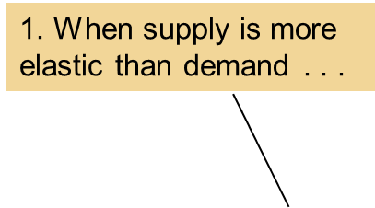
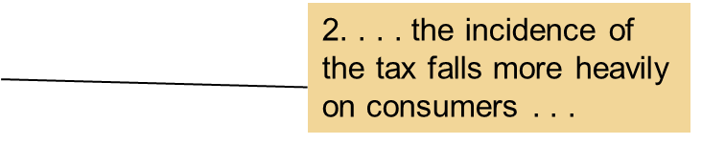

Figure 9
How the Burden of a Tax Is Divided (a)
(a) Elastic Supply, Inelastic Demand
Price
Supply
Price buyers pay
Tax
Price without tax
Price sellers
receive
Demand
0
Quantity
In panel (a), the supply curve is elastic, and the demand curve is inelastic. In this case, the price received by sellers falls only slightly, while the price paid by buyers rises substantially. Thus, buyers bear most of the burden of the tax.
© 2015 Cengage Learning. All Rights Reserved. May not be copied, scanned, or duplicated, in whole or in part, except for use as permitted in a license distributed with a certain product or service or otherwise on a password-protected website for classroom use.

Slide 39
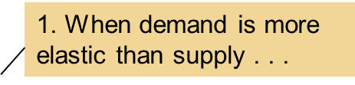

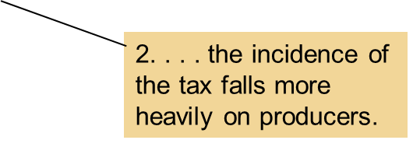
Figure 9
How the Burden of a Tax Is Divided (b)
(b) Inelastic Supply, Elastic Demand
Price
Supply
Price buyers pay
Price without tax
Tax
Demand
Price sellers
receive
0
Quantity
In panel (b), the supply curve is inelastic, and the demand curve is elastic. In this case, the price received by sellers falls substantially, while the price paid by buyers rises only slightly. Thus, sellers bear most of the burden of the tax.
© 2015 Cengage Learning. All Rights Reserved. May not be copied, scanned, or duplicated, in whole or in part, except for use as permitted in a license distributed with a certain product or service or otherwise on a password-protected website for classroom use.

Slide 40
Taxes
Tax burden
  Falls more heavily on the side of the market that is less elastic
  Small elasticity of demand
    Buyers do not have good alternatives to consuming this good
  Small elasticity of supply
    Sellers do not have good alternatives to producing this good
© 2015 Cengage Learning. All Rights Reserved. May not be copied, scanned, or duplicated, in whole or in part, except for use as permitted in a license distributed with a certain product or service or otherwise on a password-protected website for classroom use.

Slide 41
Who pays the luxury tax?
1990, Congress adopted a new luxury tax
  On yachts, private airplanes, furs, jewelry, expensive cars
  Goal: to raise revenue from those who could most easily afford to pay
  Luxury items
    Demand is quite elastic
    Supply is relatively inelastic
© 2015 Cengage Learning. All Rights Reserved. May not be copied, scanned, or duplicated, in whole or in part, except for use as permitted in a license distributed with a certain product or service or otherwise on a password-protected website for classroom use.

Slide 42

Who pays the luxury tax?
Outcome:
  Burden of a tax falls largely on the suppliers
    Relatively inelastic supply
1993: most of the luxury tax was repealed
“If this boat were any more expensive, we’d be playing golf.”
© 2015 Cengage Learning. All Rights Reserved. May not be copied, scanned, or duplicated, in whole or in part, except for use as permitted in a license distributed with a certain product or service or otherwise on a password-protected website for classroom use.

